Slide 1
DEEP LEARNING MODELS & COMPUTER VISION USING DEEP LEARNING

Slide 2
Overview
In this chapter we are going to discuss about Convolutional Neural network for image processing and Computer Vision using Open CV

Slide 3
Contents
Introduction to Convolutional Neural Networks(CNN)
Working of CNN
Layers of CNN
Computer Vision
Applications of Computer Vision
Open CV
Filtering using OpenCV
Edge detection using OpenCV

Slide 4
DEEP LEARNING MODEL:
CONVOLUTIONAL NEURAL NETWORK(CNN)
Effective at Dealing with Image Data

Slide 5

CNN

Slide 6
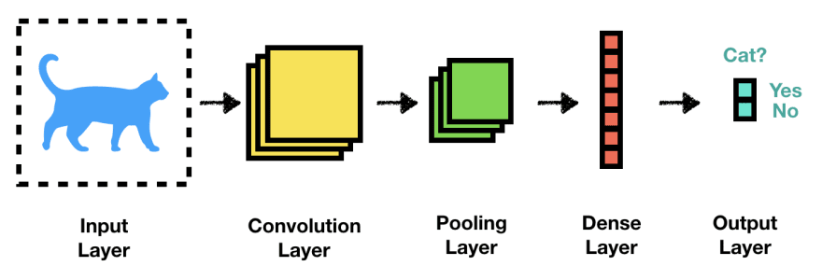
LAYERS OF CNN
CNNs have stacked layered architecture of
several Convolution and Pooling Layers

Slide 7
Understanding CNNs
Convolutional Layers.
Pooling Layers.
Fully-Connected Layers.
Padding

Slide 8

Blur Filters

Slide 9
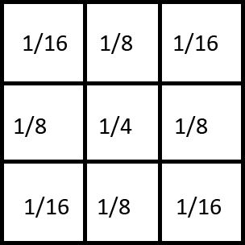
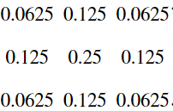
Image Kernel
Small matrix applied to an entire image
Filters are referred to as Convolution Kernels.
The process of passing the Kernels over an image is called Convolution
Blur Filter
Note : Padding can be used if you don’t want to lose border information

Slide 10
Filter
0 | 0 | 0 | 0 | 0 | 0
0 | 2 | 2 | 2 | 2 | 0
0 | 2 | 1 | 1 | 2 | 0
0 | 2 | 1 | 1 | 2 | 0
0 | 2 | 2 | 2 | 2 | 0
0 | 0 | 0 | 0 | 0 | 0
0 | 0 | 0
0 | -1 | 1
0 | 1 | -1
0X0 | 0X0 | 0X0
0X0 | 2X-1 | 2X1
0X0 | 2X1 | 1X-1
3*3 FILTER
Multiply by Filter Weights
0 | 0 | 0
0 | -2 | 2
0 | 2 | -1
SUM THE RESULT
= 1
Stride Distance = (1,1)
Note: The resolution will decrease because we are taking 9 input values and one output value

Slide 11


Slide 12
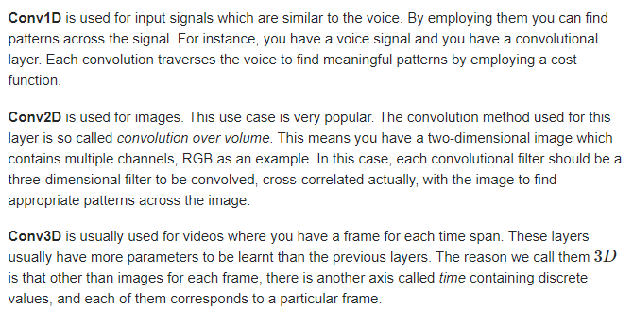
Convolution Operations

Slide 13
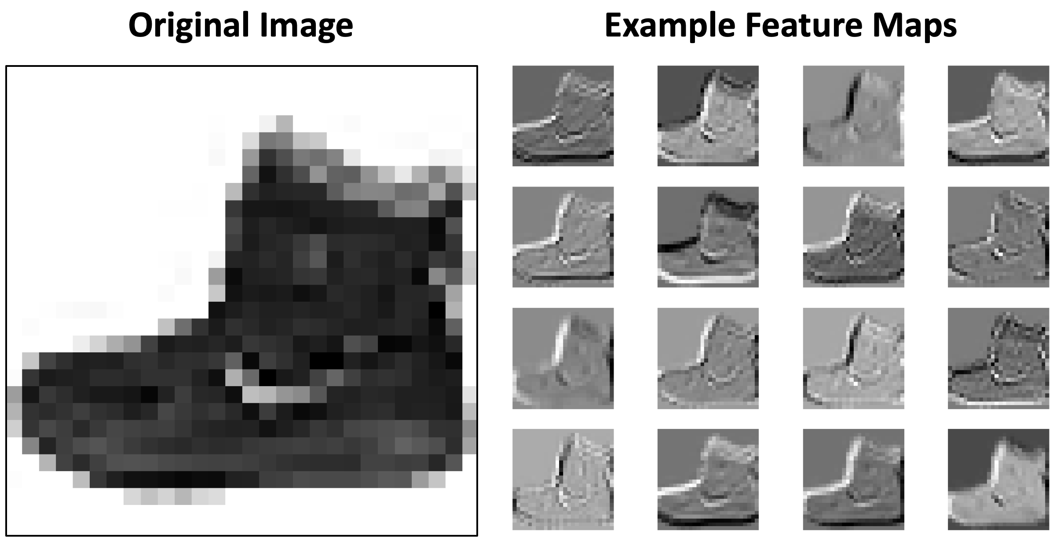
Convolutional Layers
Perform FEATURE EXTRACTION on Source Images by applying filters(eg. 16)
Understand various pattern with regard to Image Structures (Textures, Edges, Corners and Patterns)
They extract Feature Maps

Slide 14
Max Pooling
Downsamples Feature maps from Conv Layers
1 | 3 | 6 | 8
4 | 2 | 9 | 7
8 | 7 | 3 | 2
7 | 9 | 1 | 1
4 | 9
9 | 3
Window 2x2 Stride : 2
Pooling Layers help in reducing Dimensionality after convolutions(compression)

Slide 15
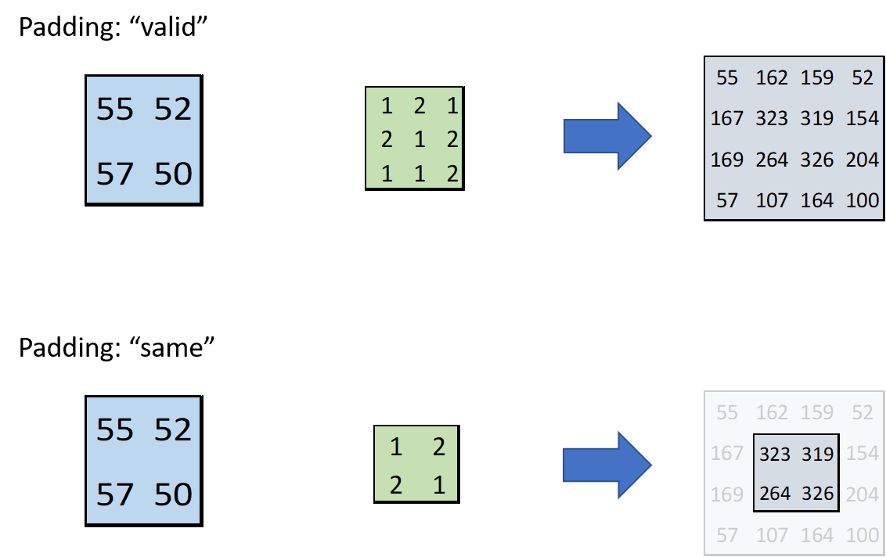
Padding
valid
same
https://miro.medium.com/max/2264/1*XUJwcj95wk-LsILwzJHaAg.png

Slide 16
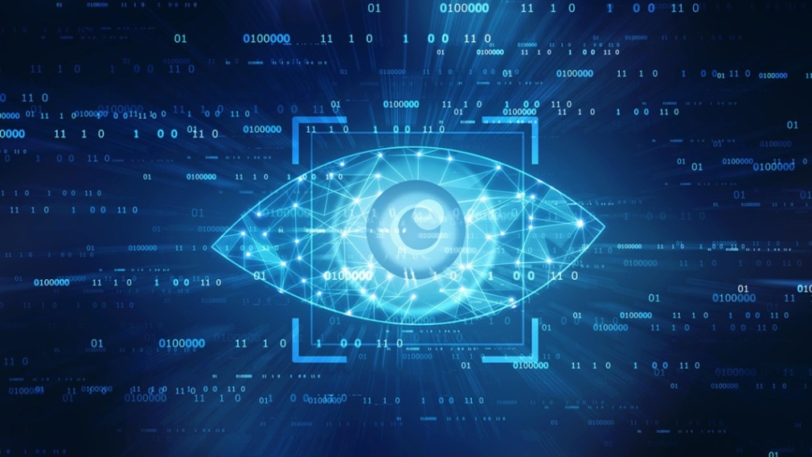
COMPUTER VISION
Gaining High-level understanding from digital images or videos

Slide 17
What is Computer Vision(CV)?
Computer vision (CV) is an artificial intelligence (AI) subcategory that focuses on developing and deploying digital systems that process, analyze, and interpret visual input.
The objective of computer vision is to allow computers to recognize an item or person in a digital image and take appropriate action.
Convolutional neural networks (CNNs) are used in computer vision to analyze visual input at the pixel level.

Slide 18
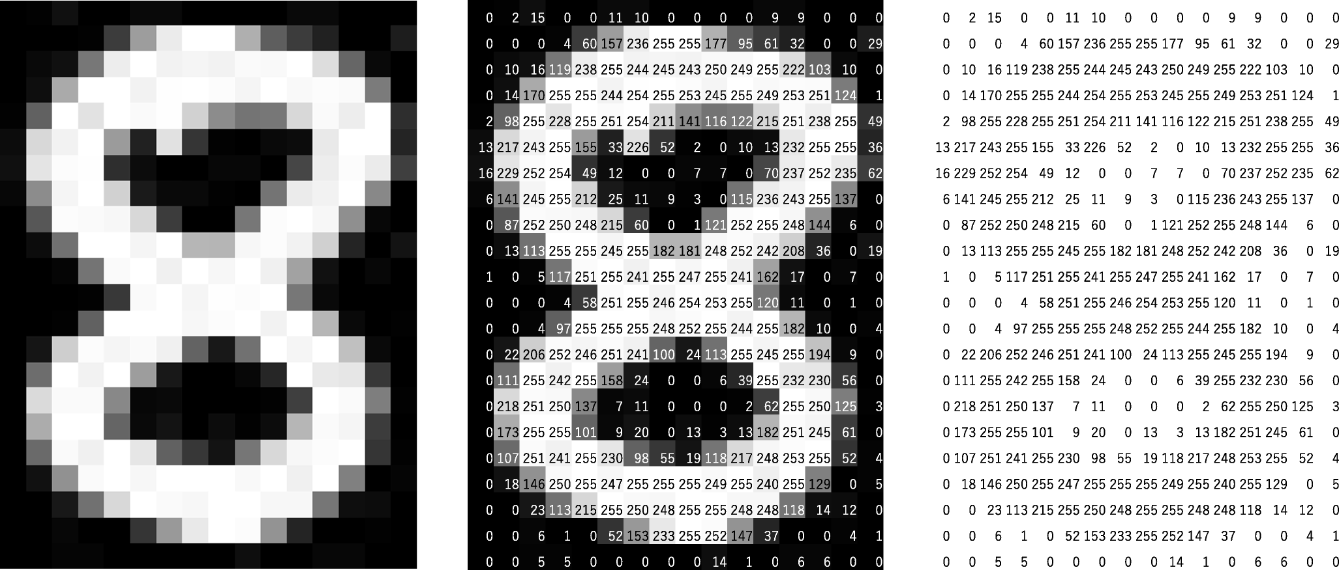
What is an Image?
Data in the form of matrix(Rows and Columns) consisting of Pixels
Image : Image with Pixels
https://mozanunal.com/images/pixel.png

Slide 19
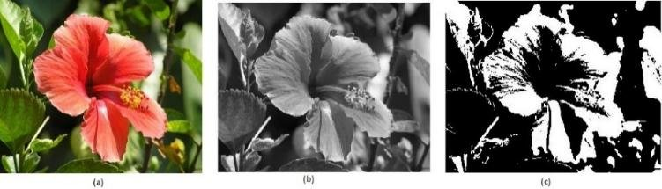
Types of Images
Color Image
Grayscale Image
Binary Image
https://www.researchgate.net/profile/Sanskruti-Patel-2/publication/344249310/figure/fig2/AS:935972338425861@1600164603821/Figure2-a-RGB-image-b-Gray-Scale-image-c-Binary-image.jpg

Slide 20
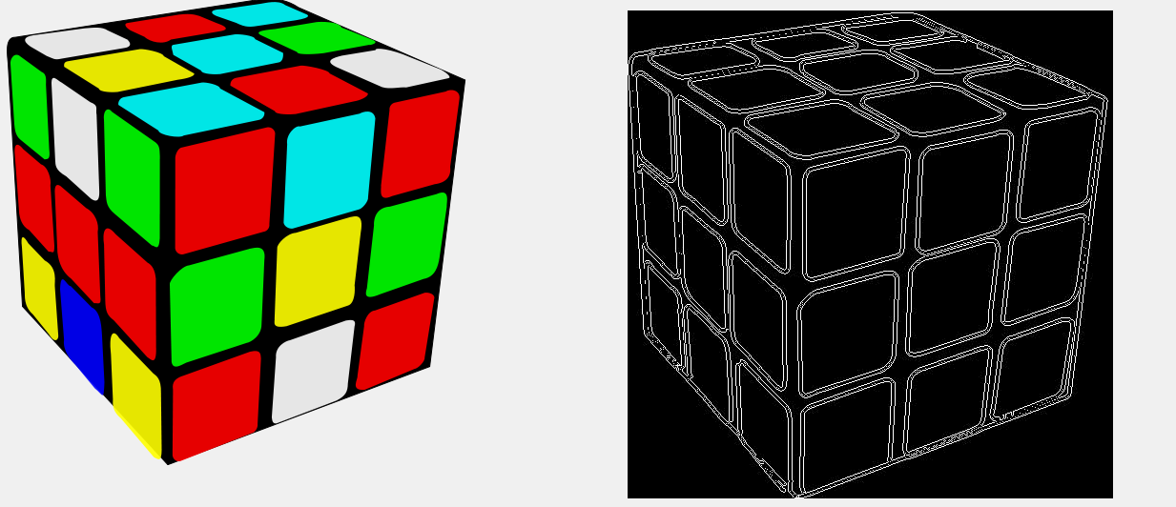
Image Processing - Edge Detection
http://4.bp.blogspot.com/-W5XdeoIeSss/UY9PpuykF4I/AAAAAAAAAkE/pNR275VKfrg/s1600/q1jjy.png

Slide 21
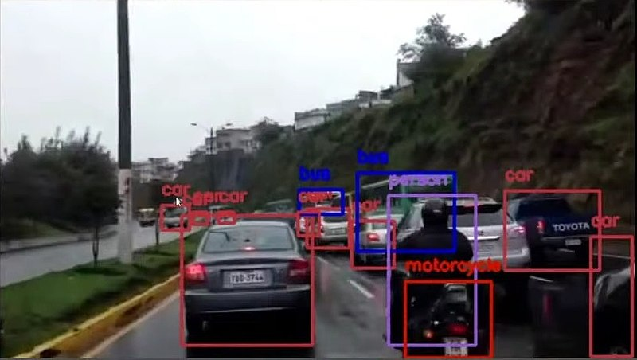
Concept of Computer Vision
Computer vision is an interdisciplinary scientific field that deals with how computers can gain high-level understanding from digital images or videos. From the perspective of engineering, it seeks to understand and automate tasks that the human visual system can do.[1]
Image reference - https://commons.wikimedia.org/wiki/File:Computer_vision_sample_in_Sim%C3%B3n_Bolivar_Avenue,_Quito.jpg

Slide 22
Why OpenCV and Python?
Open-source library for the computer vision,
machine learning, and image processing - OpenCV
More than 2500 optimized algorithms
More than 47 thousand people of user community
Python provides ease of programming
Python provides packages helpful for computations for image processing

Slide 23
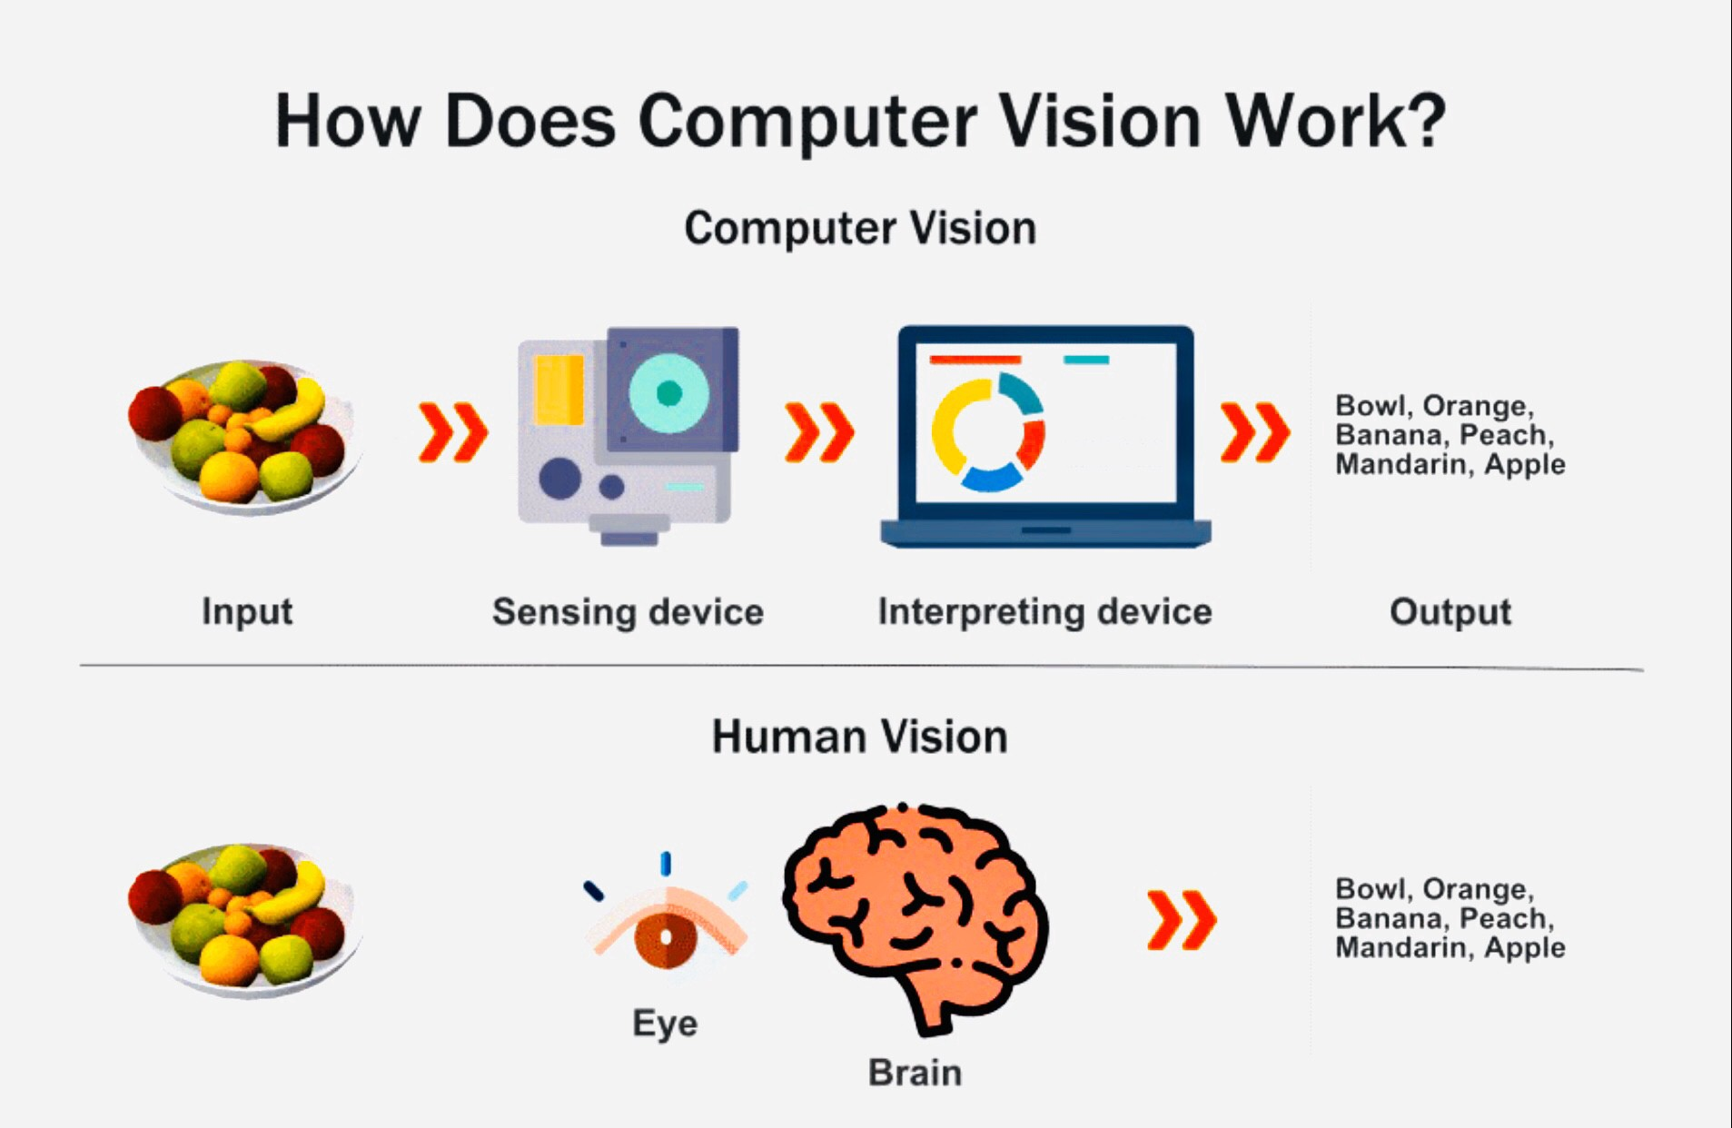
Working of Computer Vision
https://www.woodnots.com/2020/07/computer-vision-basic.html

Slide 24
Applications of Computer Vision(CV)
Computer vision may be used for a variety of purposes, including:
CV plays a crucial part in both facial and iris recognition in biometric access management.
CV lets industrial robots and self-driving automobiles to avoid accidents and travel safely.
CV may be used in conjunction with other forms of artificial intelligence programming to automate the examination of X-rays and MRIs in digital diagnostics.
CV allows mixed reality programs to know where a virtual item should be positioned using augmented reality.

Slide 25





Popular Python Libraries for CV

Slide 26
Basic Operations on Images using OpenCV(CV2)
OpenCV is Open Source Computer Vision
Main operations in OpenCV are:
Modify pixel values by gaining access to them.
Image attributes may be accessed.
Choosing an Image Region (ROI)
Image Splitting and Merging

Slide 27
Functions for accessing image using OpenCV
Importing OpenCV library:
import cv2
Loading an image :
img=cv2.imread(“cat.jpg”)
Splitting and Merging Image Channels: When necessary, an image's B, G, and R channels can be split into their component planes. The different channels may then be merged to generate a BGR picture once more.
b,g,r=cv2.split(img)
img=cv2.merge((b,g,r))
Making Borders for Images (Padding):
You may use the cv2.copyMakeBorder() method to build a border around an image, similar to a photo frame. However, it has additional uses for convolution operations, zero padding, and so forth.

Slide 28
Functions from OpenCV
Reading images and display
cv2.imread(path)
cv2.imshow(“name of window”, image)
Capturing video
object = cv2.videoCapture(path)
image = object.read()
Converting images to grayscale
cv2.cvtColor(image, cv2.COLOR_BGR2GRAY)
Blurring images
cv2.GaussianBlur(image, kernel , sigma)
Edge detection
cv2.Canny(image,threshold)

Slide 29
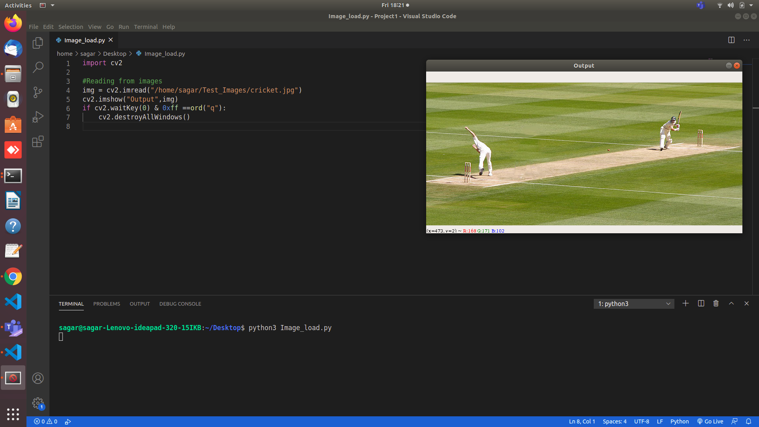
Reading an Image using CV2
Image Reference - https://commons.wikimedia.org/wiki/File:Cricket_picture.jpg

Slide 30
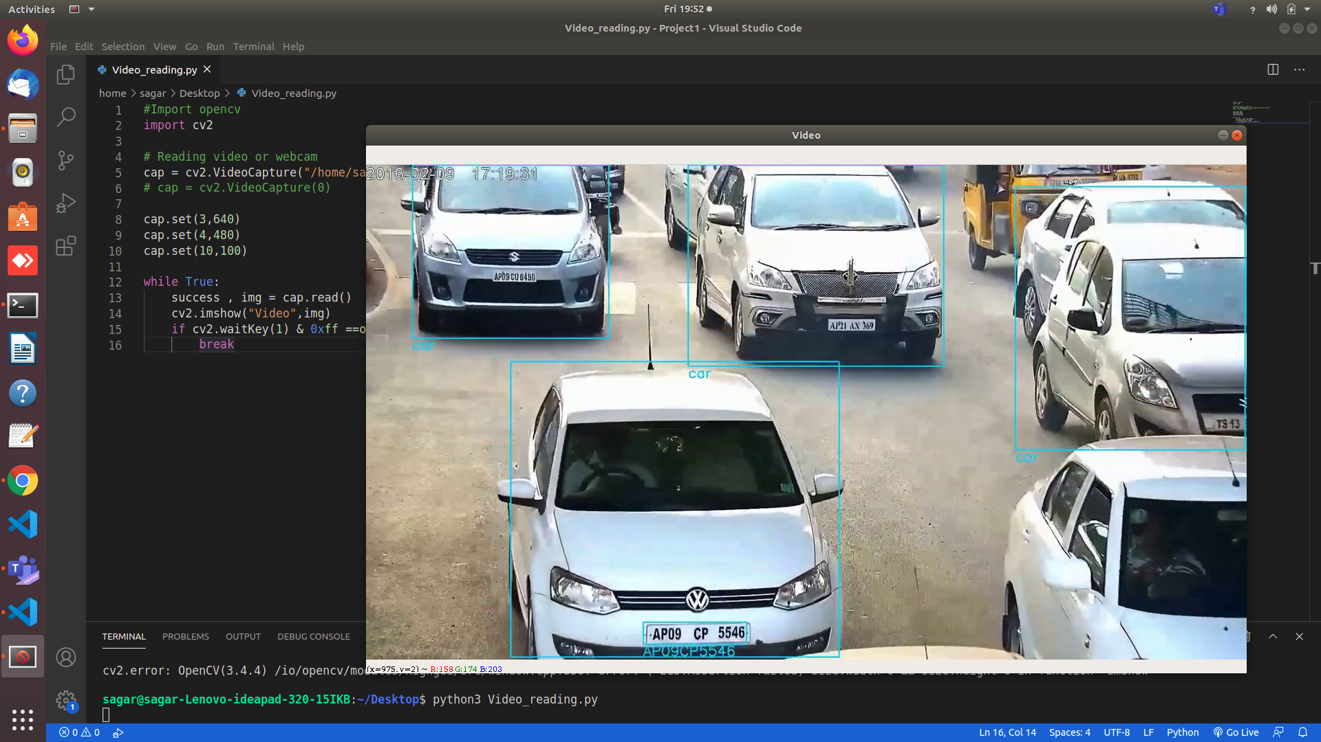
Capturing Video using CV2
Video reference - https://www.youtube.com/watch?v=dyf5c1iX5Xc

Slide 31
Dilate and Erode operations
Dilation of images
cv2.dilate(canny_image, kernel , iterations )
Erode images
cv2.erode(dilated_image , kernel , iterations )

Slide 32
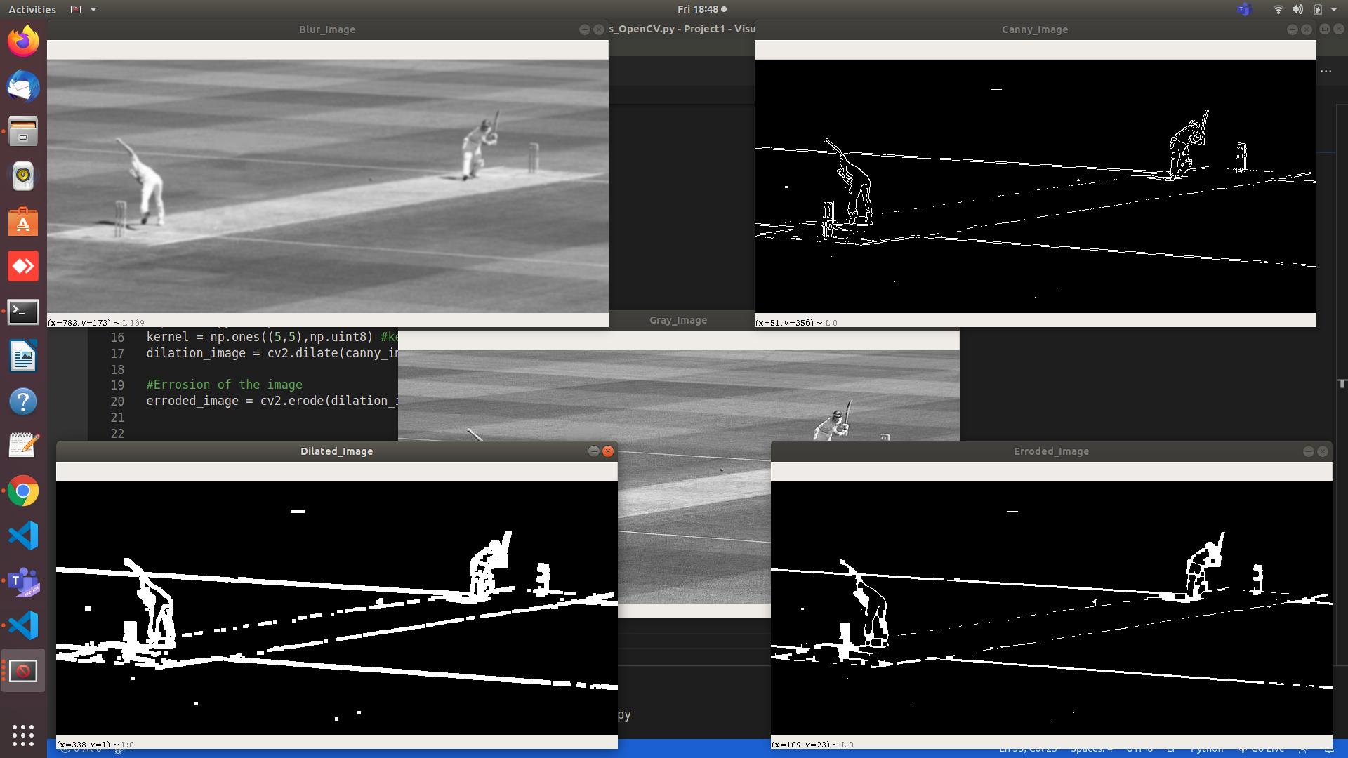
Dilation and Eroding of Images

Slide 33
Resizing and Cropping of images
Resize image
cv2.resize(img , (width,height))
Cropping of image
image[width_slice , height_slice]

Slide 34
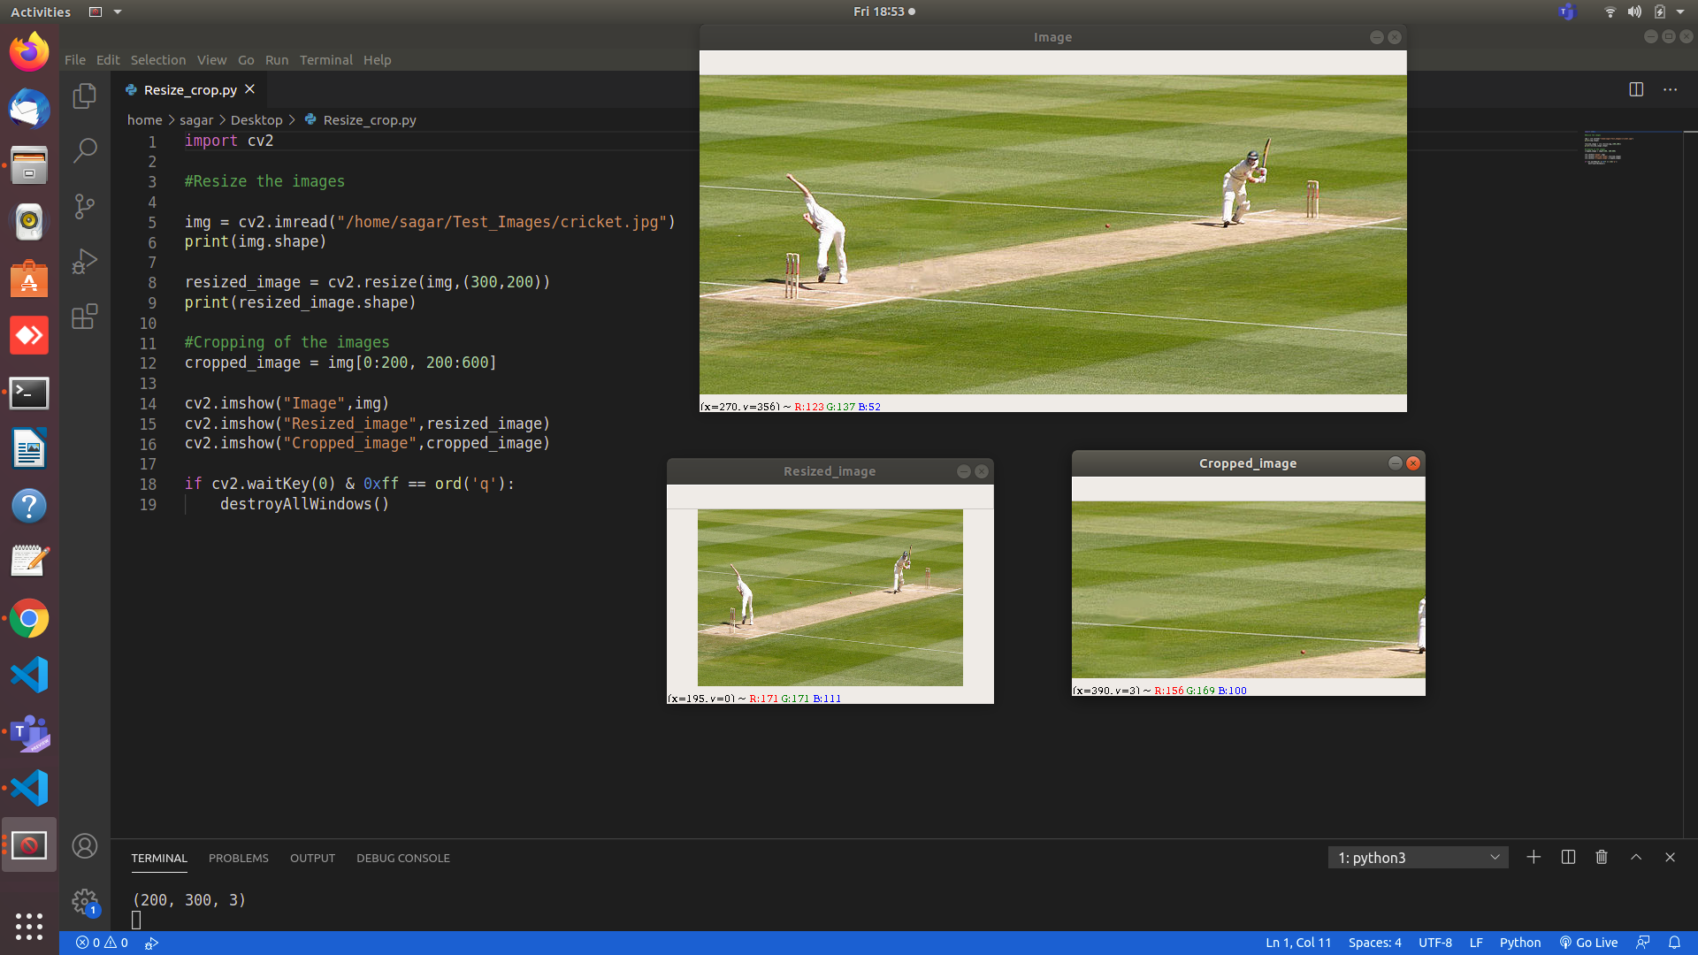
Resizing and Cropping Operation

Slide 35
Wrapping and Joining images
Image Wrapping
cv2.warpPerspective(img,matrix,(width,height))
Joining images
np.hstack((img,img))
np.vstack((img,img))

Slide 36
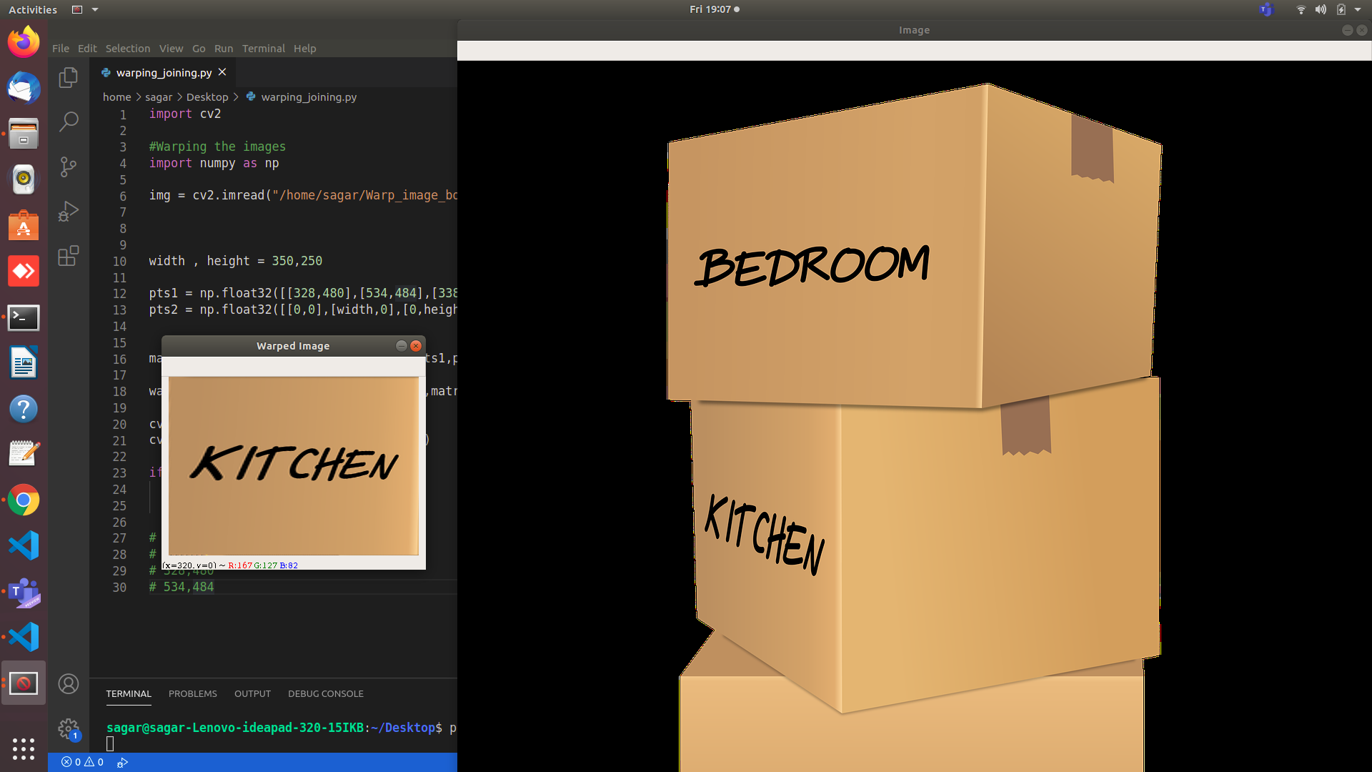
Wrapping Operation
Image reference - https://www.needpix.com/photo/download/1835425/moving-boxes-carton-boxes-stack-of-moving-boxes-pile-of-moving-boxes-cardboard-boxes-packing-packaging-storage-cartons-free-illustrations

Slide 37
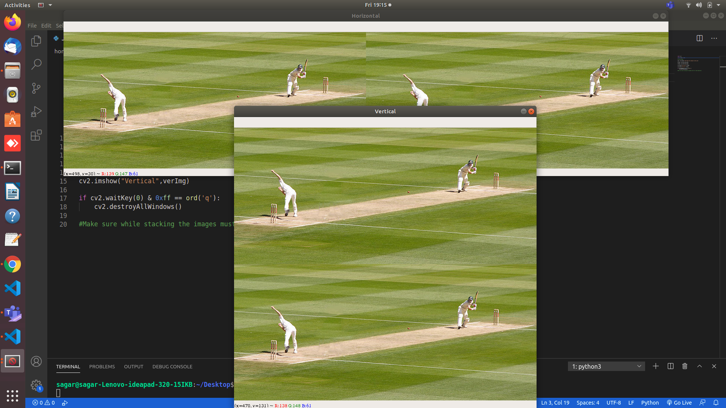
Joining Operation

Slide 38
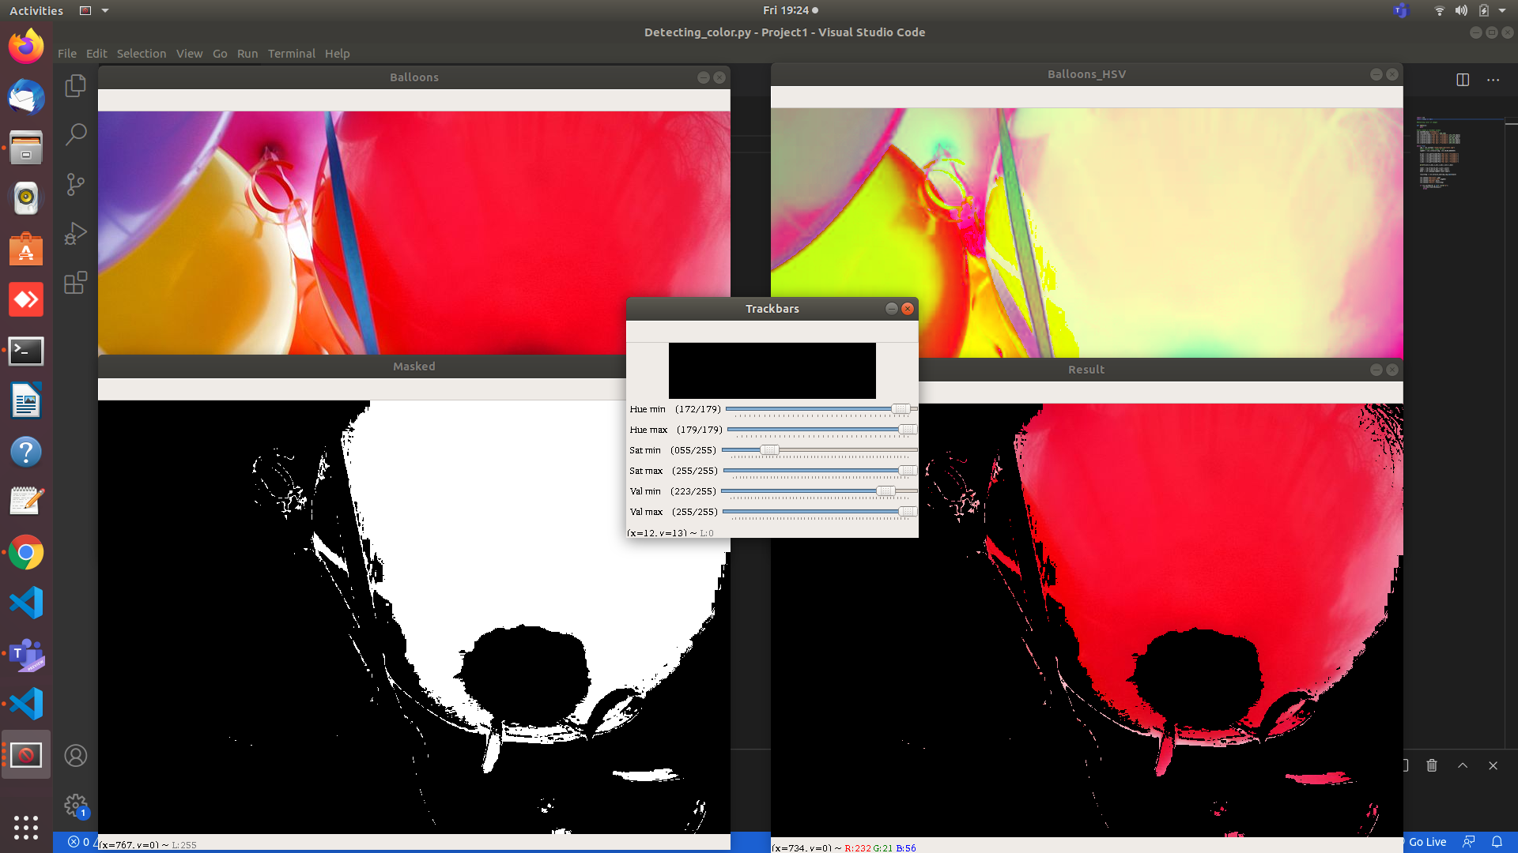
Detecting colors from image
Image reference - - https://commons.wikimedia.org/wiki/File:Happy_balloons.jpg

Slide 39
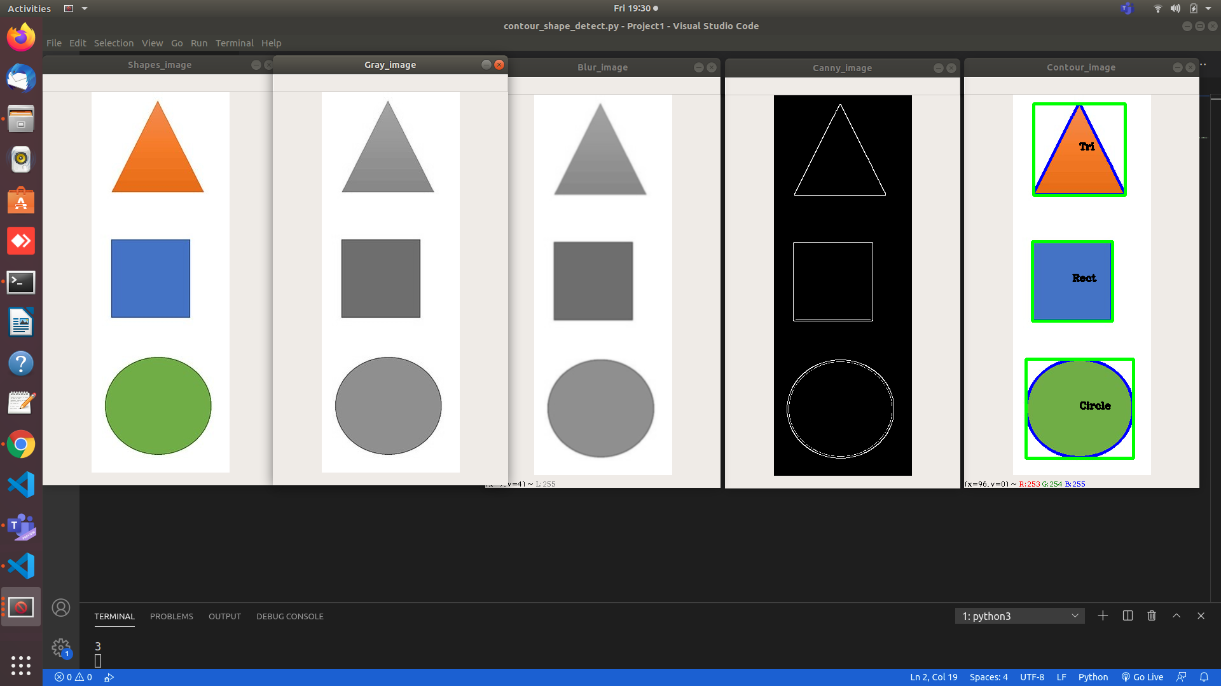
Contour and shape detection
Contours
cv2.findContours(img,cv2.RETR_EXTERNAL,cv2.CHAIN_APPROX_NONE)
Image reference - https://commons.wikimedia.org/wiki/File:Seriation_task_w_shapes.jpg

Slide 40
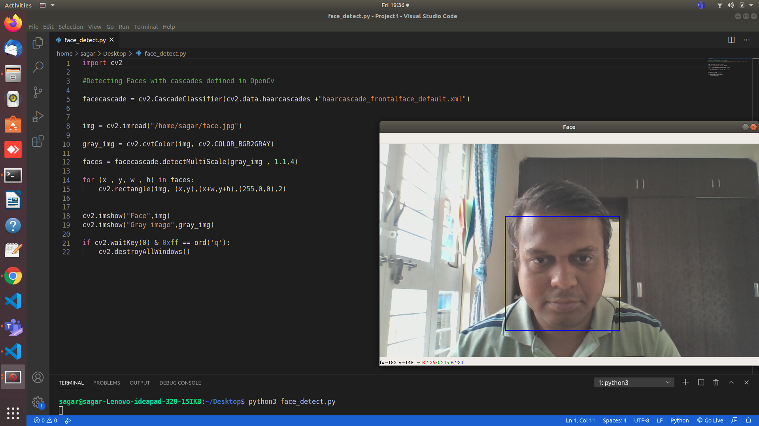
Face detection with Haar Cascade
Predefined cascade
cv2.CascadeClassifier(path for the cascade file)

Slide 41
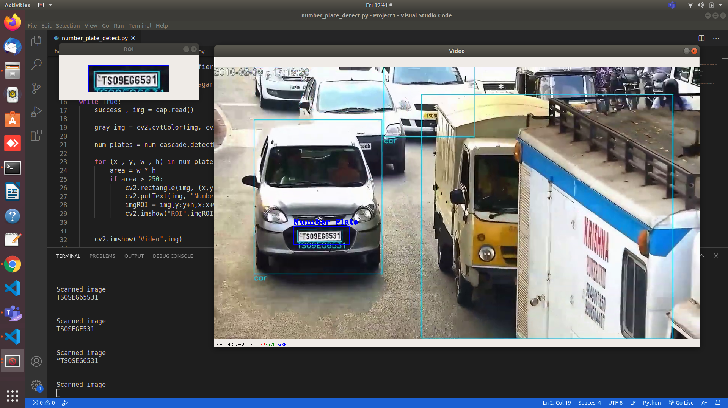
Number plate detection with Haar cascade

Slide 42
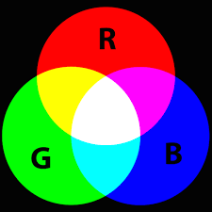
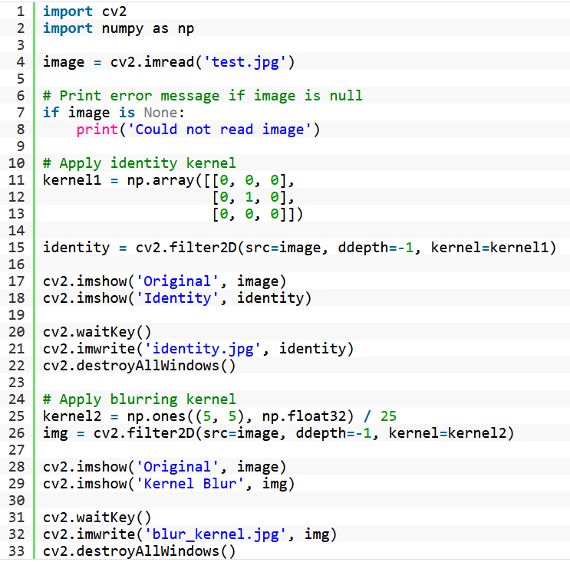
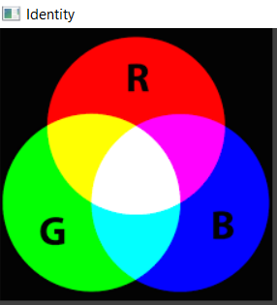
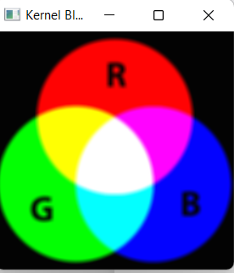
Sample code for Image Filtering Using Convolution in OpenCV
Ref: https://learnopencv.com/image-filtering-using-convolution-in-opencv/

Slide 43
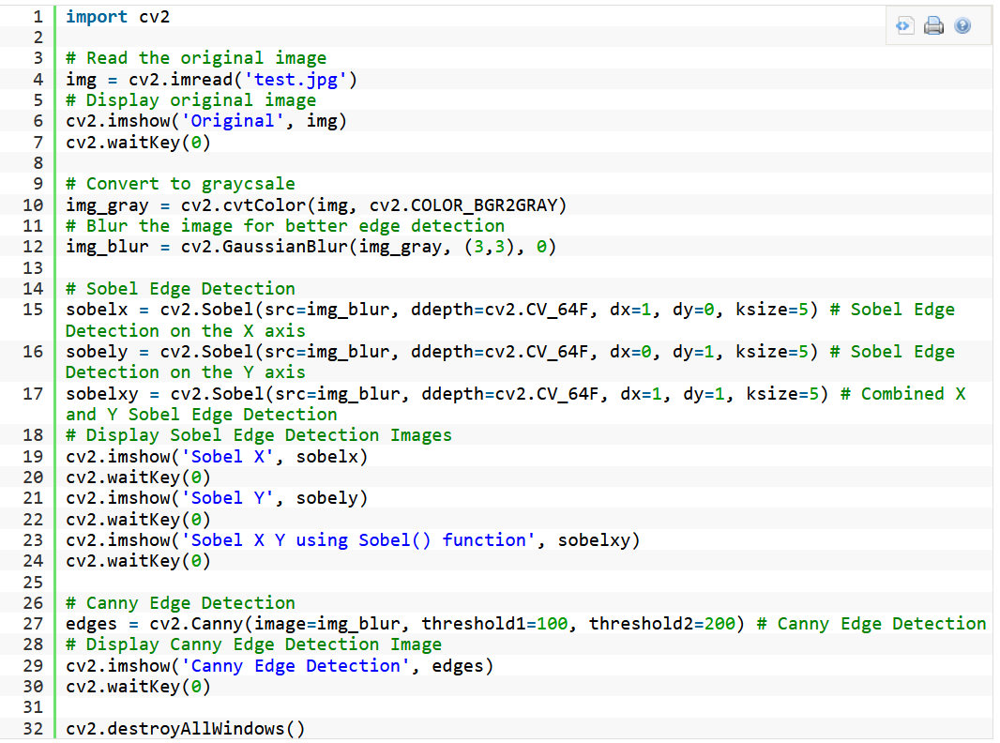
Edge Detection Using OpenCV
Ref : https://learnopencv.com/edge-detection-using-opencv/
Notes:
Edge detection is a type of image processing that identifies the boundaries (edges) of objects or areas within an image. Edges are one of the most significant characteristics of photographs. We learn about an image's underlying structure by looking at its edges. As a result, edge detection is widely used in computer vision processing pipelines.

Slide 44

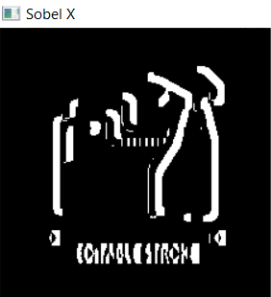
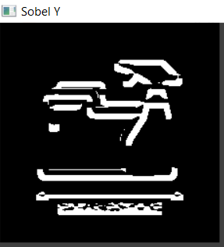
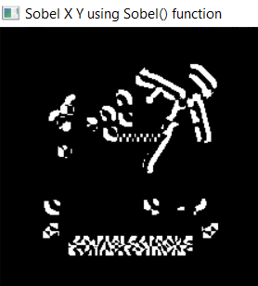
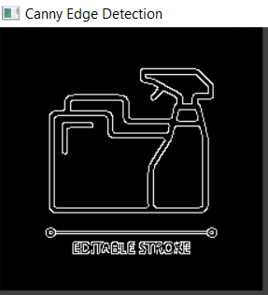
Results of Sobel and Canny Edge detection using open CV

Slide 45
Key Takeaways
Computer vision is an artificial intelligence field that teaches and enables computers to comprehend the visual environment.
Computers can effectively recognize and classify items and react to them using digital photos and deep learning algorithms.
OpenCV – Open Source Computer Vision is one of the most widely used tools for computer vision and image processing tasks.

Slide 46
References
https://www.cs.ryerson.ca/~aharley/vis/
https://setosa.io/ev/image-kernels/
https://towardsdatascience.com/understand-transposed-convolutions-and-build-your-own-transposed-convolution-layer-from-scratch-4f5d97b2967
https://www.simplilearn.com/tutorials/deep-learning-tutorial/deep-learning-algorithm

Slide 47
THANK YOU

